Slide 1
IOT and PLC based smart home system with PV inverter
Project Guide
Ms. Athira Prasad
Assistant Professor
Department of Electronics and Communication Engineering
Mar Athanasius College of Engineering,
Kothamangalam
Team members
1. Mathew Varghese
2. Ameer Fayiz
8th Semester
Department of Electronics and
Communication Engineering
Mar Athanasius College of Engineering,
Kothamangalam

Slide 2
PROBLEM DEFINITION
IOT systems employ WiFi technology, which cause spectrum crowding in the 2.4GHz free band
Potential health hazards of wifi in residential areas are yet to be researched
Expensive routers and repeaters required to cover large houses and public areas like bus stands.
Current systems can be manipulated by hackers due to lack of proper security or tappable wifi hotspots
CURRENT DEVELOPMENT IN THIS AREA
People are moving towards decentralised energy production and are in dire need of secure and efficient ways to transfer electricity and information

Slide 3
OUR SOLUTION
Use wired communication
Use powerline for communication so as to reduce wires
Implement an IOT dashboard so as to control and monitor appliances
Collect usage data so that it can be used to predict the energy usage
Incorporate solar panel to this system so that users can generate electricity
Implement an MPPT to maximise the solar energy output

Slide 4
OBJECTIVES
Broad Objectives
Design and implement an IOT based smart home system with a PV inverter which communicates using PLC and implement MPPT circuit to maximise solar output
Precise Objectives
Develop an ecosystem for implementing power line communication on IOT systems .Also we aim to encourage the use of solar cells by integrating a solar inverter which uses an MPPT along with the PLC control system and making it open source.

Slide 5
APPLICATIONS/ SOCIO ECONOMIC RELEVANCE
Decentralised energy production encourages the use of green energy
Less dependency on centralized power generation
Optimise power usage by predictive analysis and automation
Control and monitor the status of devices via internet or mobile application
Provide analytics on the energy usage pattern of households.
Open source IOT based smart pv inverter system encourages further development in this area

Slide 6
ABSTRACT
We eliminate the need for this broad wifi coverage for smart homes by communicating control signals over the powerline itself. The system consist of a solar inverter, a main PLC control box and a control box at every switchboard.The control unit is provided with internet access either via lan cable or via wifi modem. All the switchboards and appliances will be connected to the control unit via existing powerline itself. We implement an inverter system with lead acid battery for the PV system and the energy usage pattern of all the connected homes can be recorded and analyzed.
The main control box is connected to the internet which enables the whole system to be communicated remotely via a website or mobile app. This also enables us to do the analytics on the usage pattern of households and energy usage prediction. We also design an MPPT for the solar ups system to maximise the energy generation.
The inverter market is dominated by a few individuals and majority of the companies buy rights from these proven designers and this increases the cost of them. We aim to make it open source so that engineering community can work on it and thus benefit from the knowledge generated by doing this project.

Slide 7
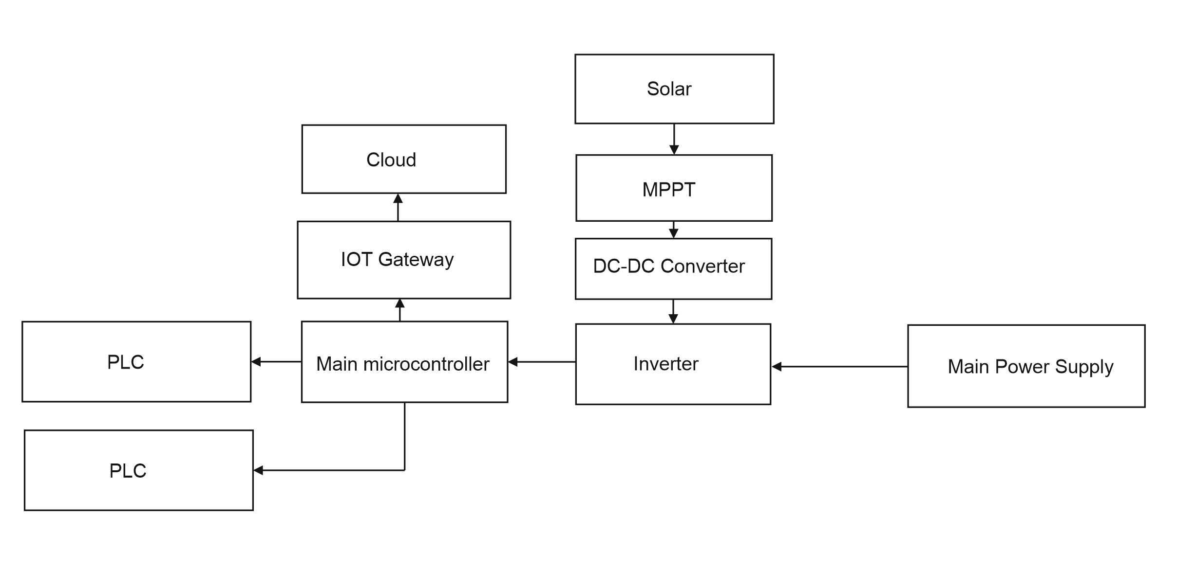
PROPOSED METHODOLOGY
HARDWARE BLOCK DIAGRAM

Slide 8
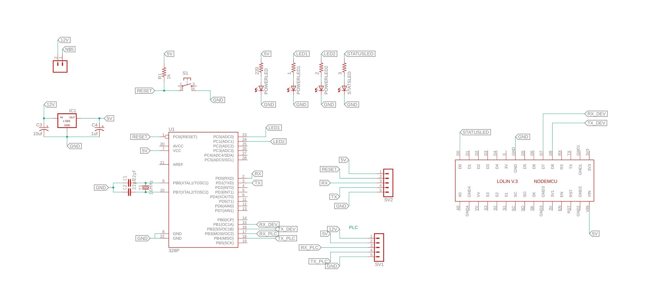
Base station

Slide 9
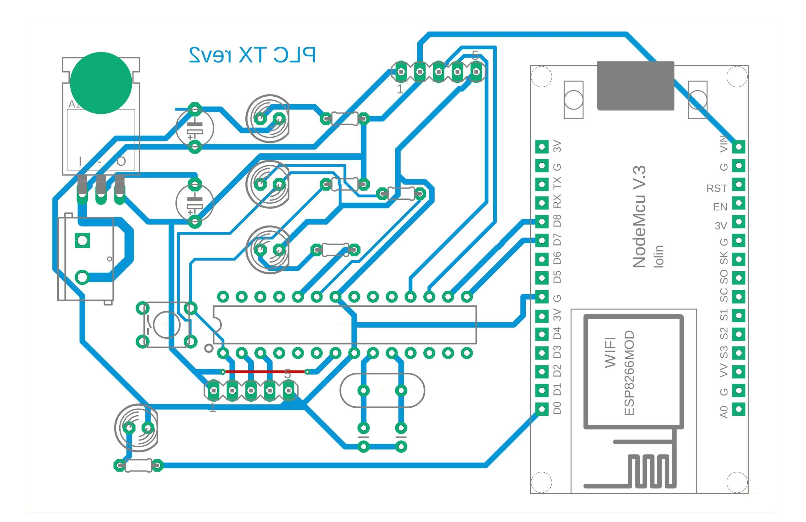
Base station

Slide 10
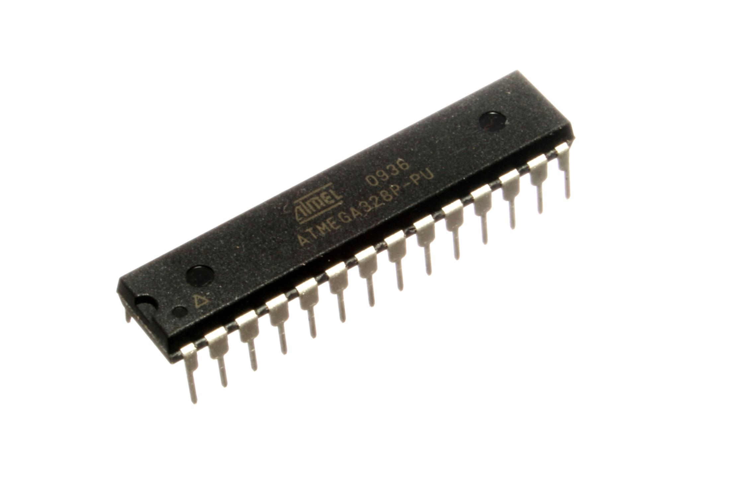
Main microcontroller used
Atmega 328P-PU
28 pin
23 GPIO
SPI, I2C, UART
5v supply
16 MHz clock
32 KB memory
2 KB ram

Slide 11
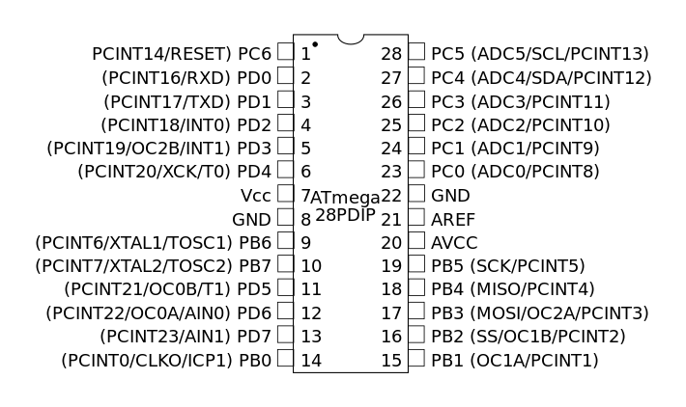
Atmega 328P-PU
pinout

Slide 12
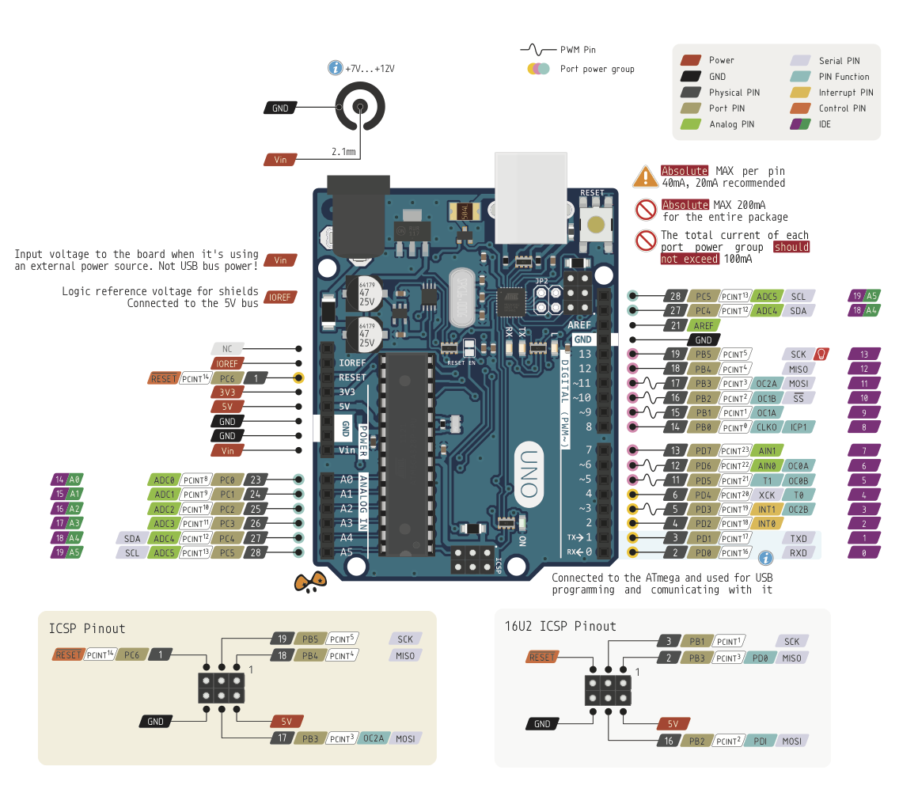
Arduino Uno
Pinout

Slide 13
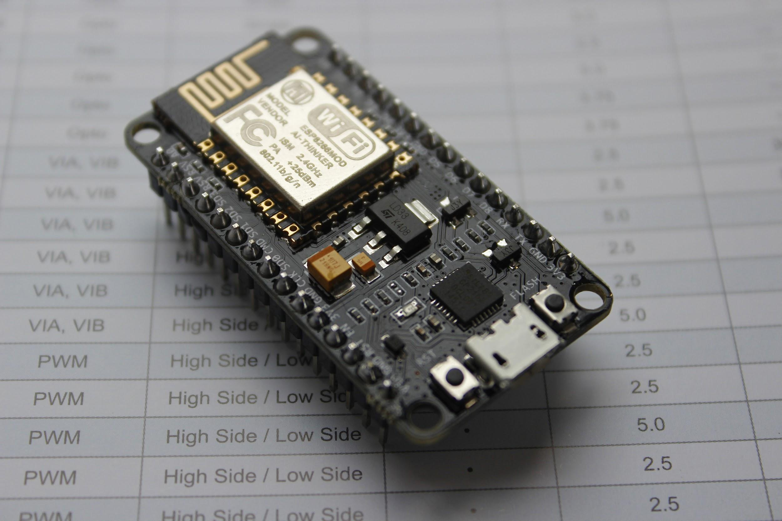
NODEMCU
Based on ESP12E module
Arduino support available
Integrated TCP/IP stack

Slide 14
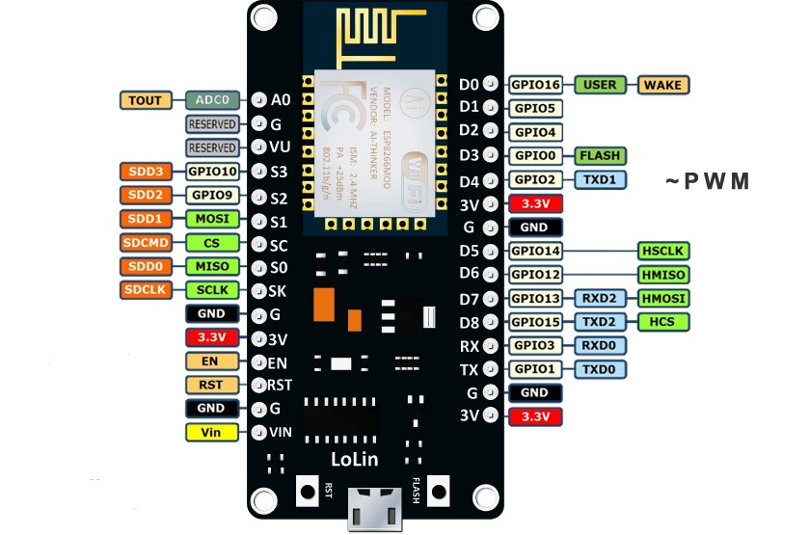
NODEMCU
pinout
16 GPIO
1 PWM
32 KB RAM
SPI,I2C,UART,I2S
10 bit ADC
We use a softwareserial on GPIO14 and GPIO15 and hardwareserial on GPIO3 And GPIO1

Slide 15
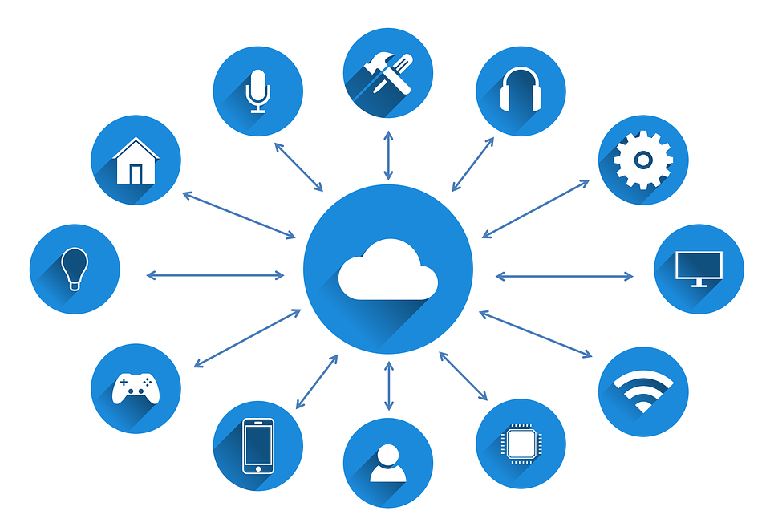
IOT Dashboard
Thinger.io

Slide 16
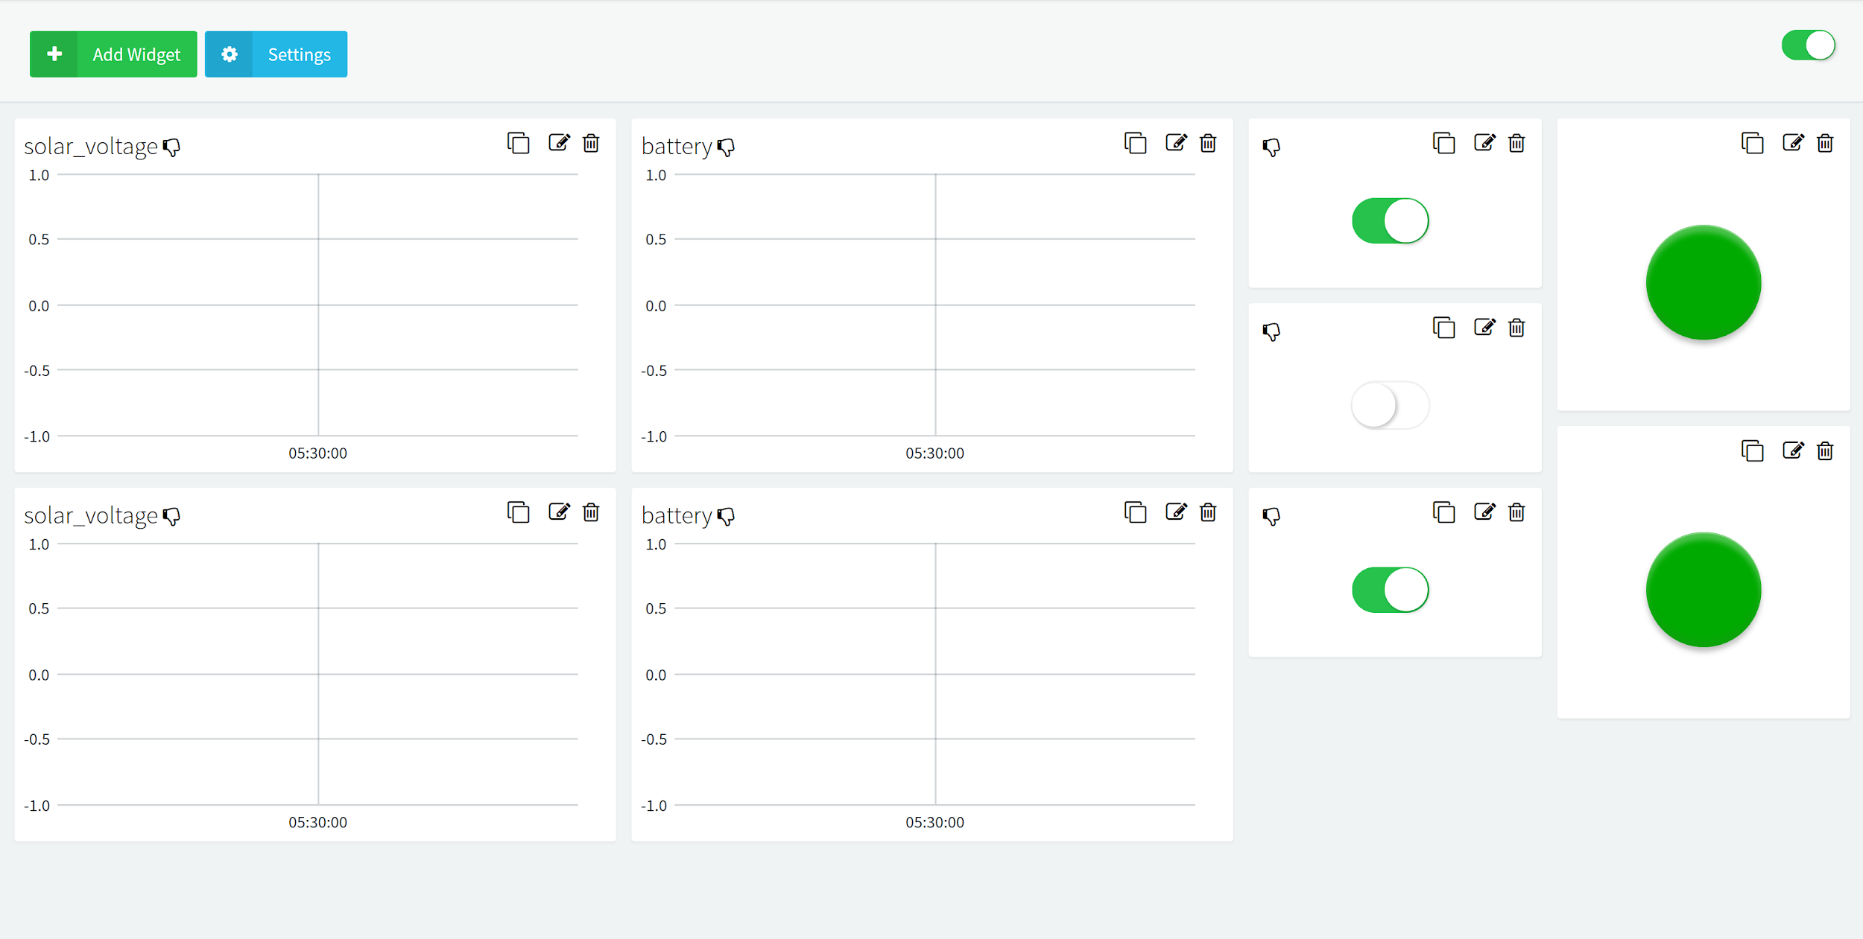

Slide 17
Power Line Communication Modem
Default Baudrate of 9600.
Communication in half duplex mode.
Working environment: 230V 50/60Hz
Communication distance: 150m
Power line carrier frequency: 72kHz
Modulation and demodulation mode: FSK

Slide 18
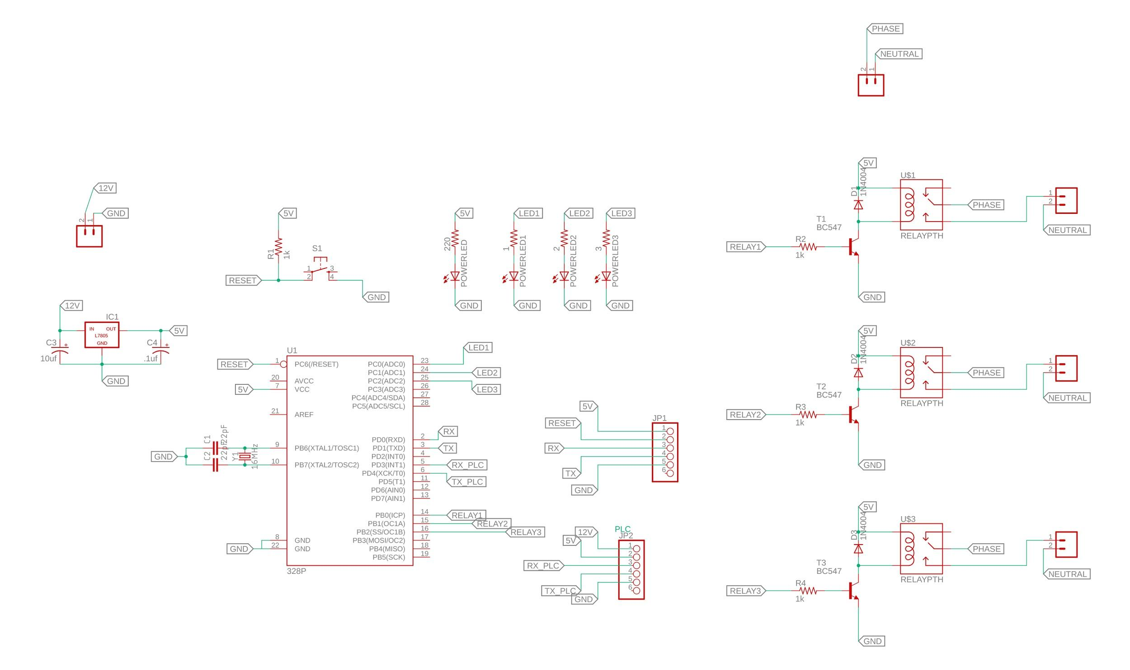
Receiver node

Slide 19
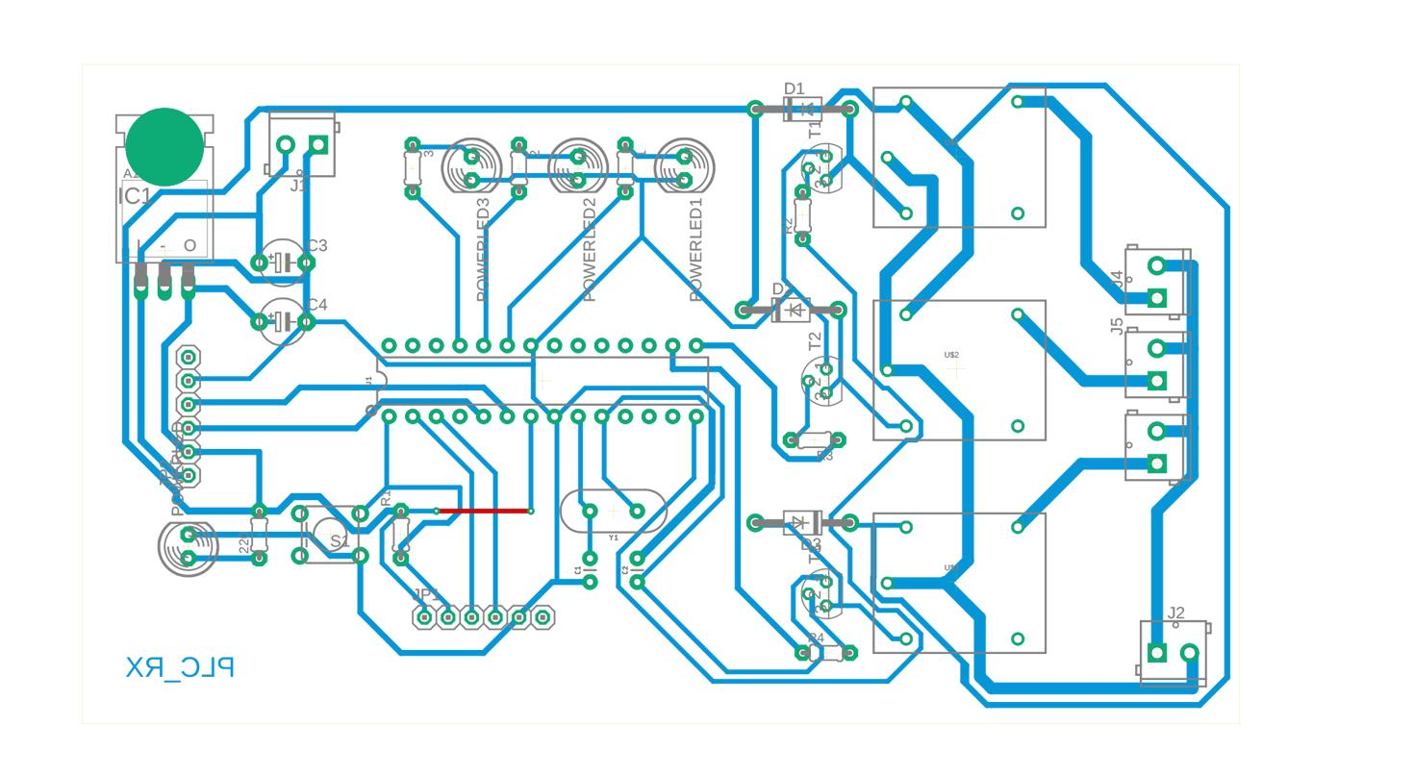
Receiver node

Slide 20
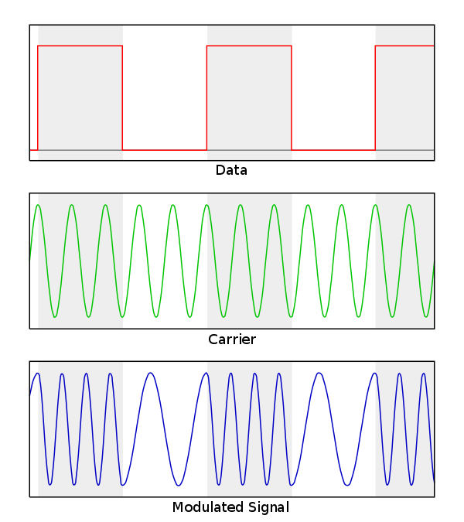
Frequency Shift Keying(FSK)
FSK is the digital modulation technique in which the frequency of the carrier signal varies according to the digital signal changes

Slide 21
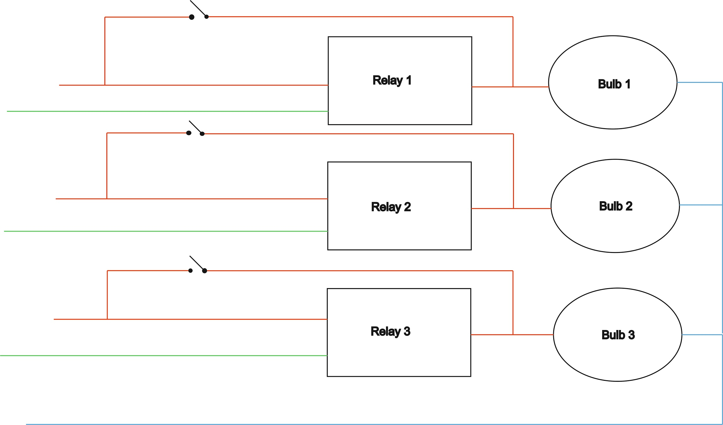
Device Connection diagram

Slide 22
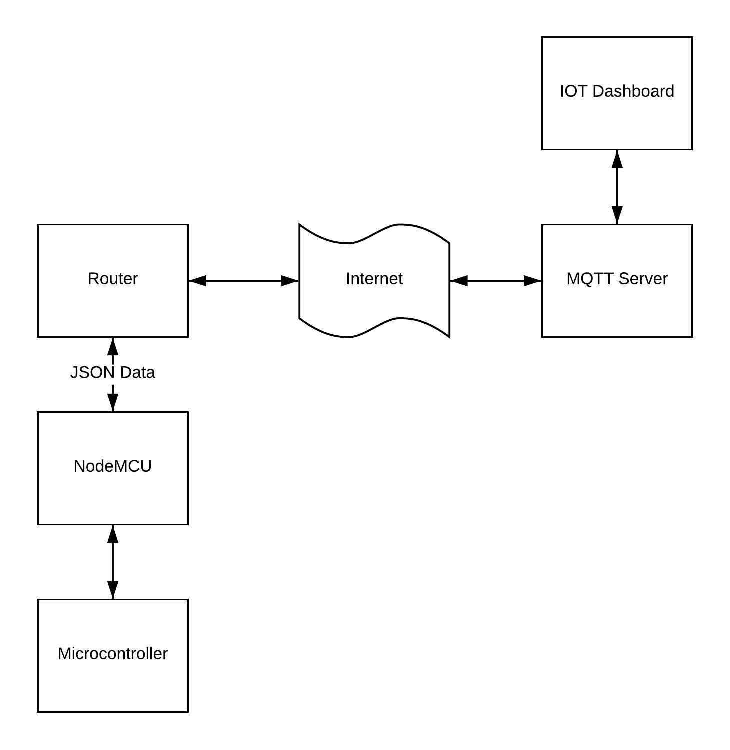
Internet of things system

Slide 23
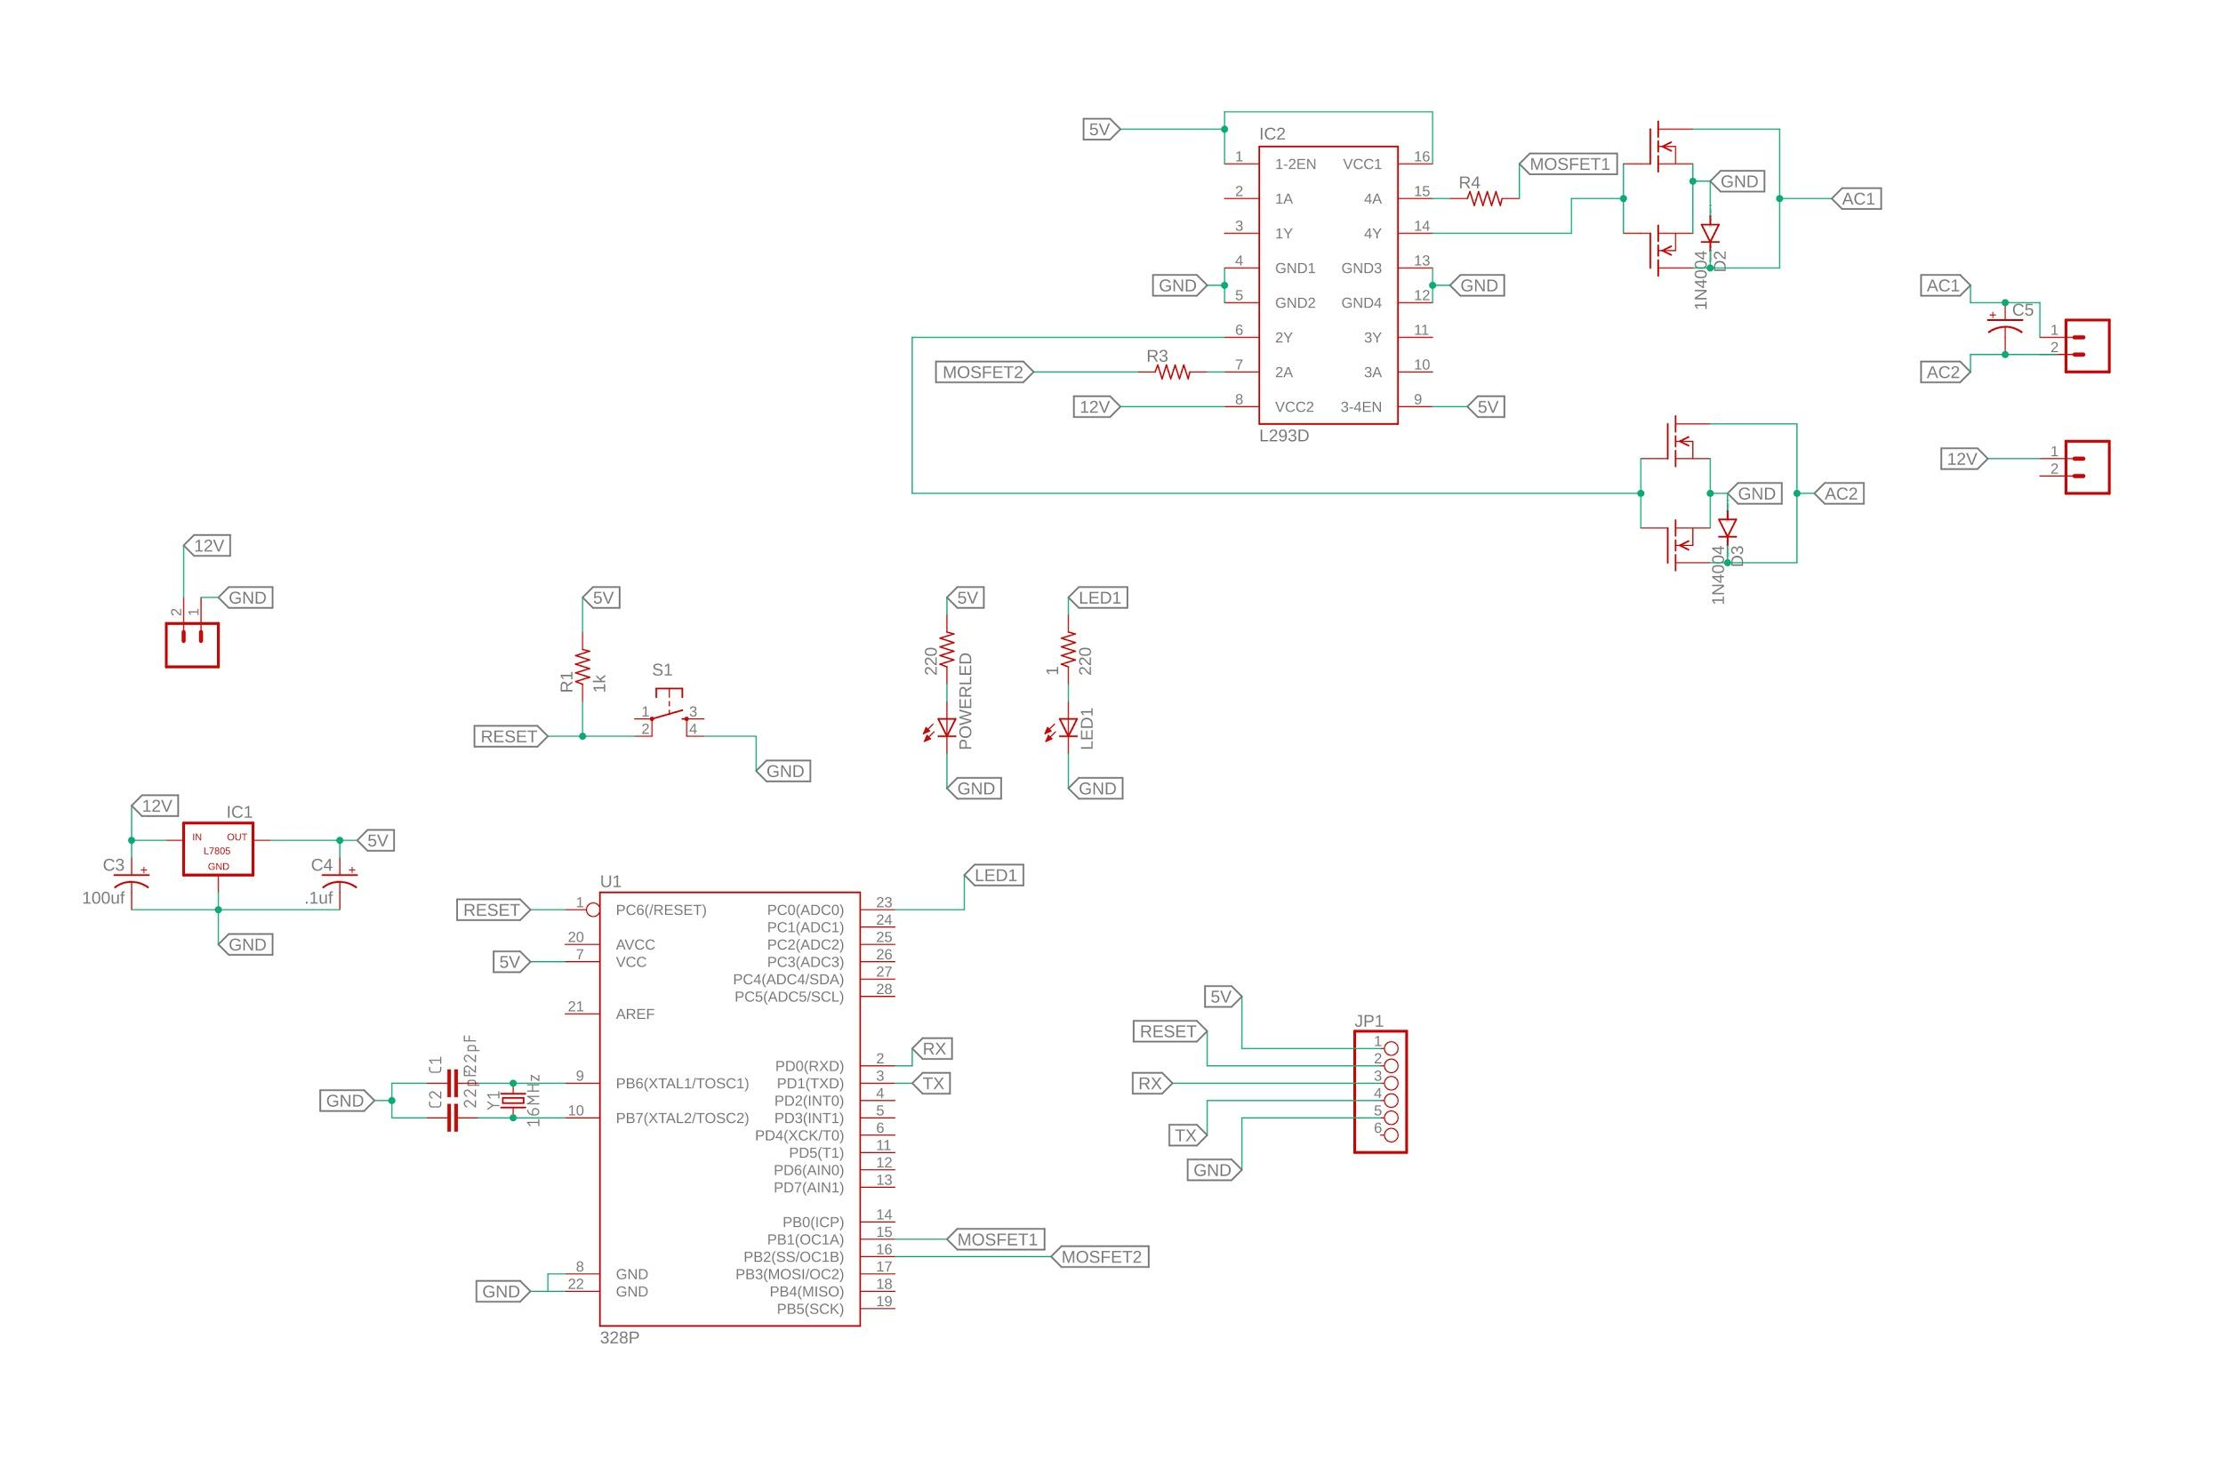
Pure sine wave Inverter

Slide 24
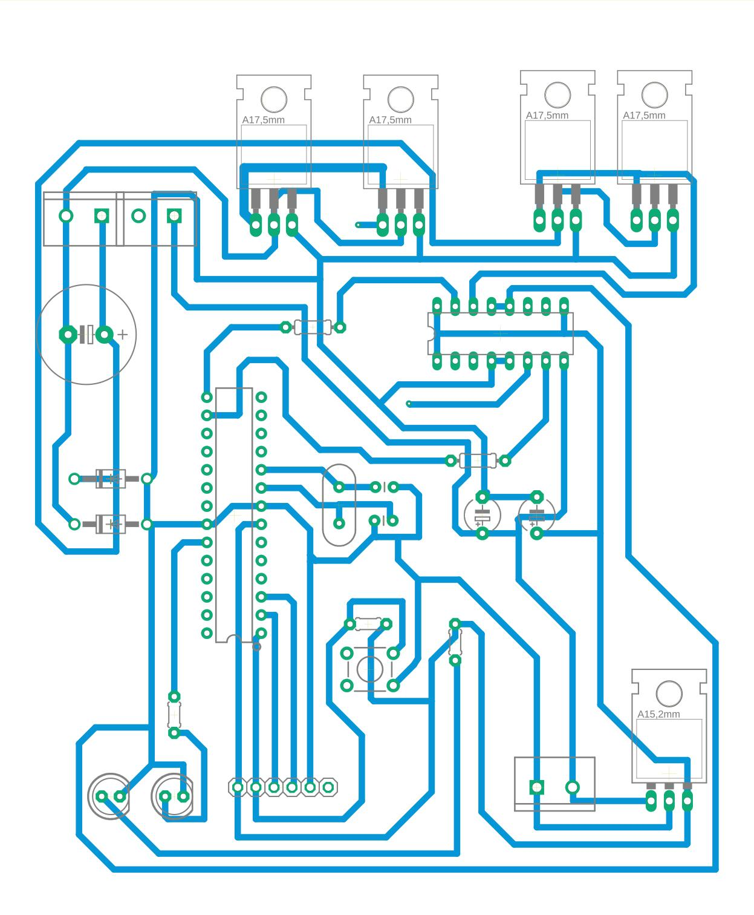
Pure sine wave Inverter

Slide 25
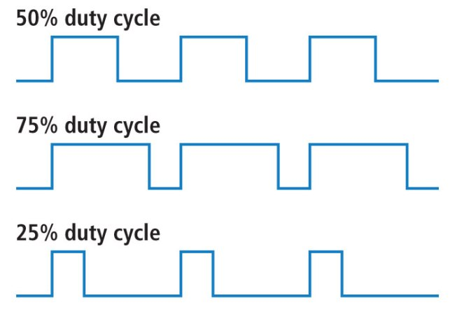
PWM

Slide 26
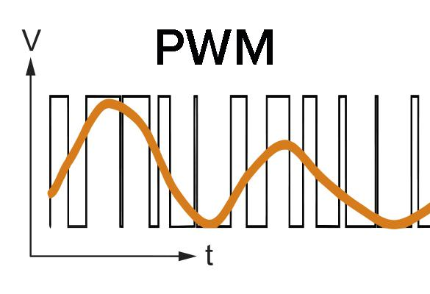

Slide 27
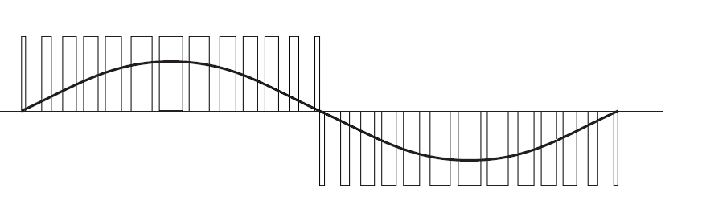
SPWM
Sinusoidal pulse width modulation

Slide 28
Atmega328 PWM frequency
Max attainable at 16 MHz clock: 62.5 KHz
490 Hz for arduino

Slide 29
Lead Acid Batery
12Ah 12V
Max voltage 14.5v
11v-12.6v
1c charging

Slide 30
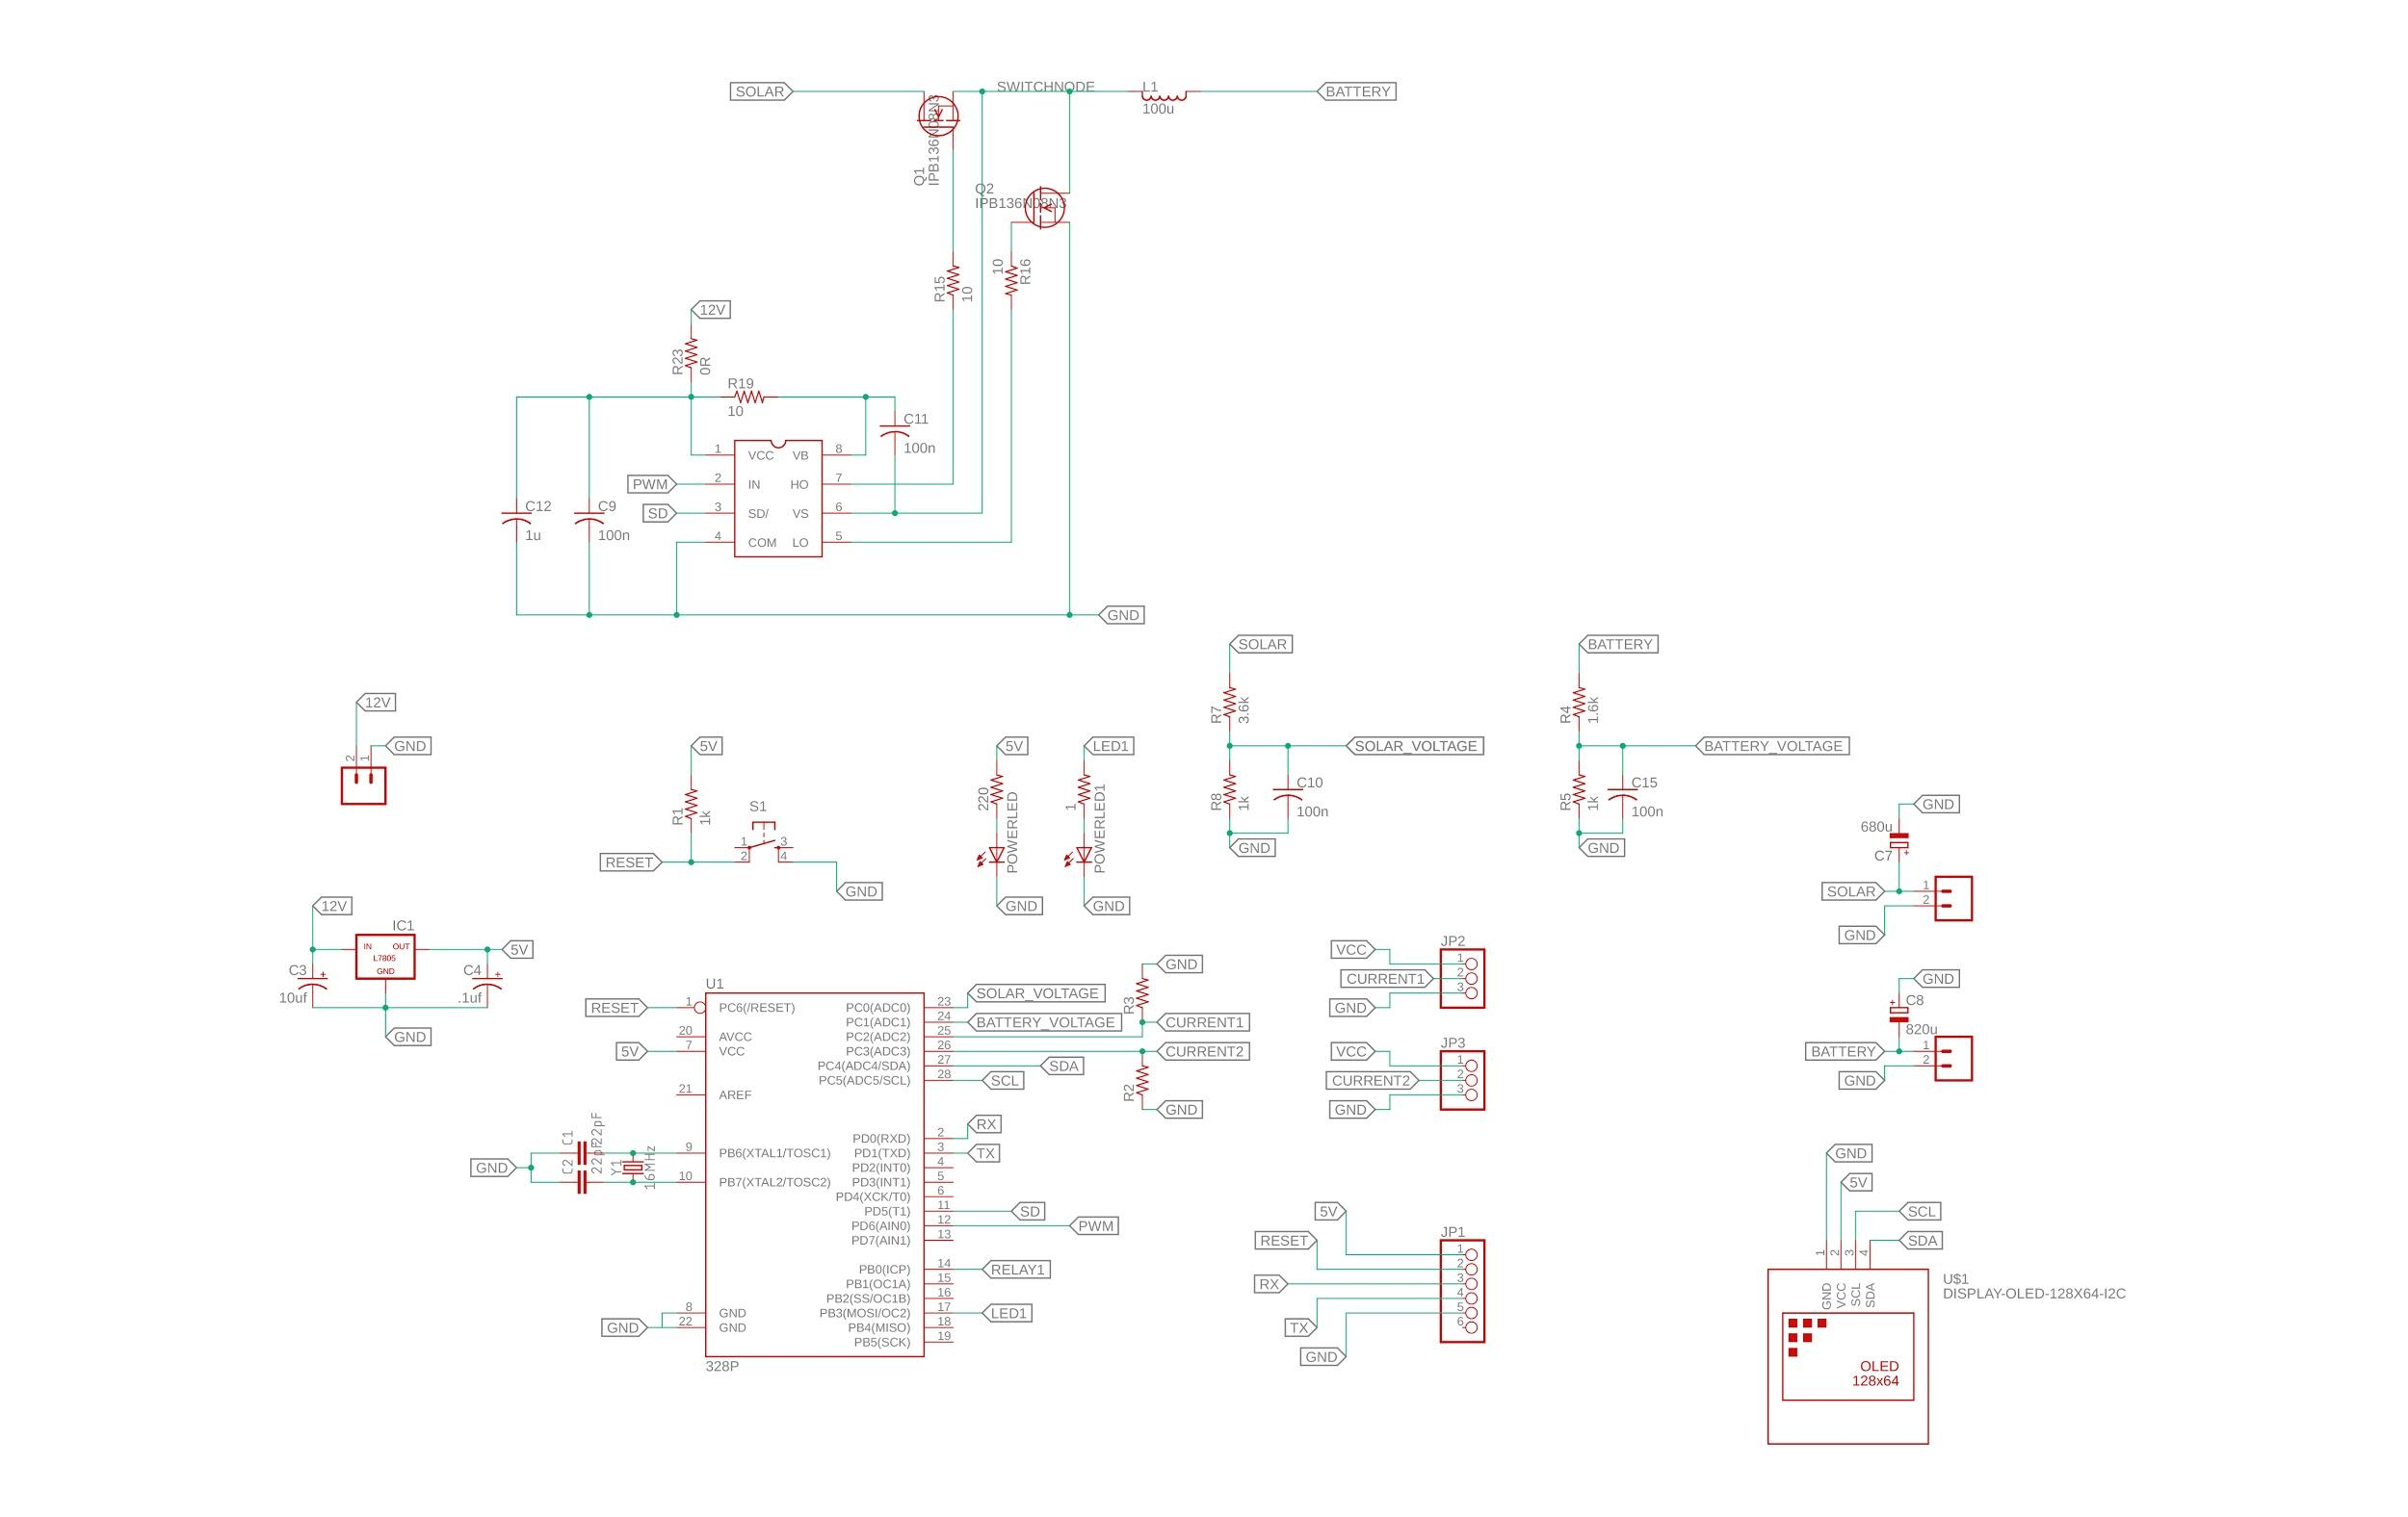
Charge Controller

Slide 31
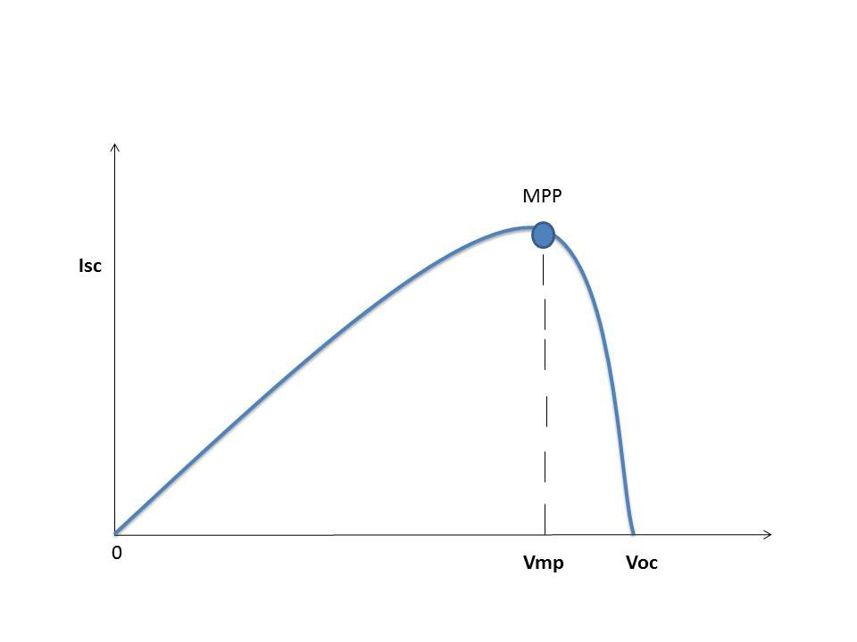
MPPT
MPPT charge controllers used for extracting maximum available power from PV module under certain conditions.The Maximum Power Point Tracker (MPPT) circuit is based around a synchronous buck converter circuit. It steps the higher solar panel voltage down to the charging voltage of the battery. The Arduino tries to maximize the watts input from the solar panel by controlling the duty cycle to keep the solar panel operating at its Maximum Power Point.
Maximum Power Point Tracking

Slide 32
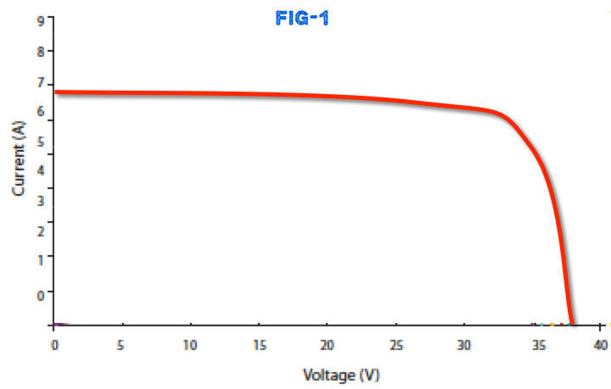
Factors affecting power output of solar panel
1.The amount of sun light
2.The connected load
3.The temperature of the solar panel.

Slide 33
We use perturb and observe algorithm
In this method the controller adjusts the voltage by a small amount from the array and measures power; if the power increases, further adjustments in that direction are tried until power no longer increases

Slide 34
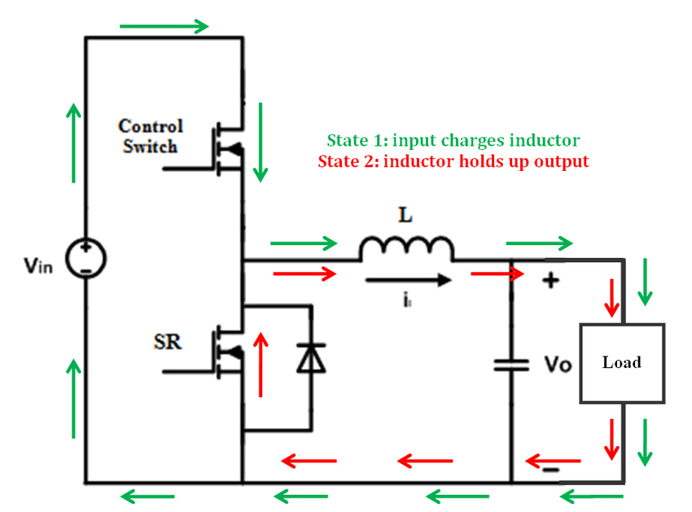

Slide 35
Solar Panel
Pmax:25W
Vmax:17V
Imax:1.5A
Voc:21.5V
Isc:1.61A

Slide 36
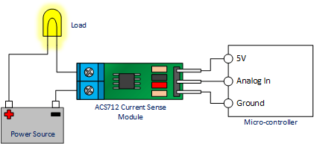
Current sensor
ACS712

Slide 37
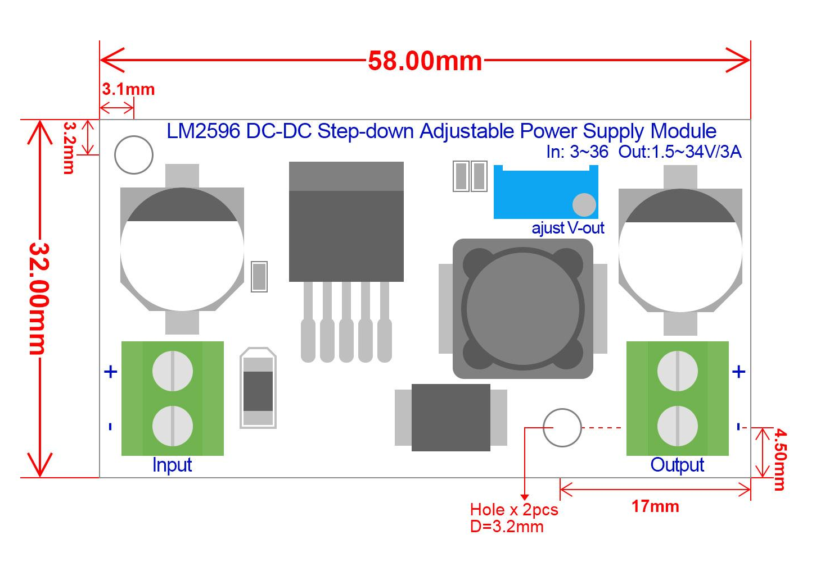
buck converter module

Slide 38
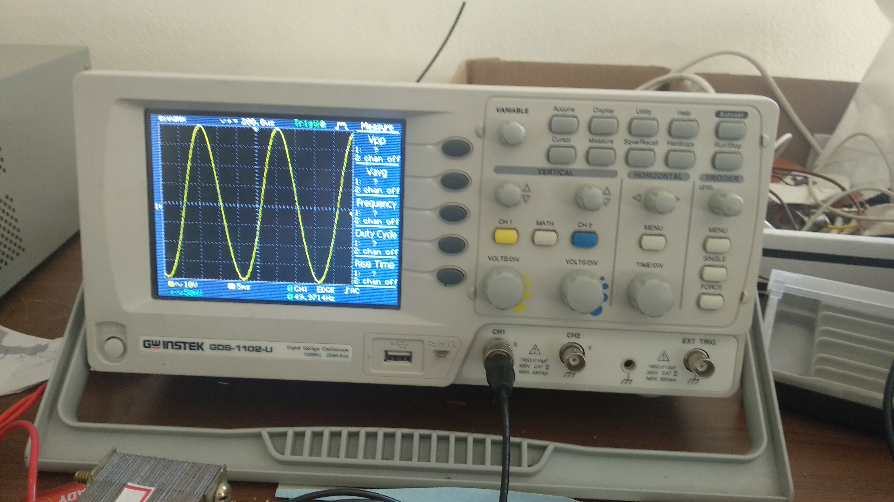
Result

Slide 39
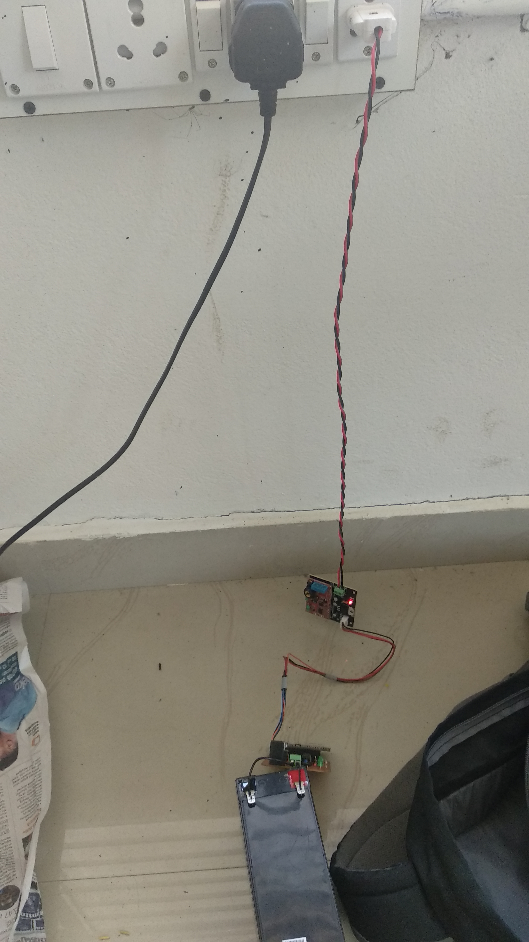

Slide 40
Advantages
All components are easily available in local market
Cost of the components are low
The code and hardware is available under open source github repos(made by us)
Well documented code

Slide 41
Problems faced
The arduino resets randomly when switching on the inverter. This was due to SPWM interference and another PCB was designed.
Getting the component of rated current(inductors)
Getting the PLC communication IC(From mouser, required clearance certificate, which we didnt knew)
Finding people working on the field of PLC

Slide 42
Disadvantages
No shortcircuit and overvoltage protection for the inverter( can be easily added to the existing project)
Practically, PLC communication is possible only in low speeds (100bps) till 200 metres. Wire may have more length in proposed use case
PLC is sensitive to noise in the AC system
MPPT not sensitive to fast varying conditions and temperature is assumed to be constant

Slide 43
Future Scope
The whole project is opensource implying that further development can be coordinated via git system which allows version control and issue tracking.
A blockchain based energy trading can be implemented so that a secure and transparent energy marketplace can be created.

Slide 44
REFERENCES
https://ieeexplore.ieee.org/document/1343222
https://en.wikipedia.org/wiki/Blockchain
https://www.mckinsey.com/~/media/mckinsey/dotcom/client_service/risk/working%20papers/47_energy_trading.ashx
https://wiki.opensourceecology.org/wiki/Inverter
http://docs.thinger.io/
https://soldernerd.com/2016/01/21/arduino-mppt-solar-charger-shield/

Slide 45



